Slide 1
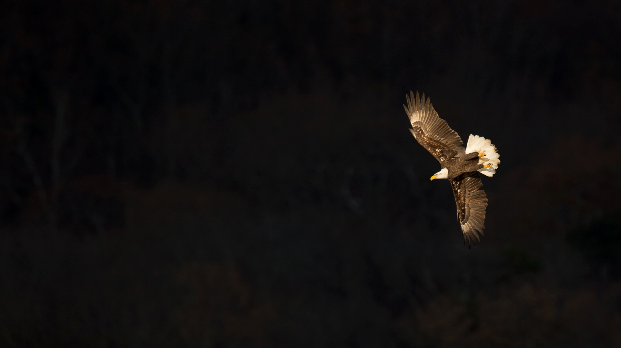
WILDLIFE
IMPULSE
Project By: Gauri Bankar (595) & Rutuja Gholap (581)

Slide 2
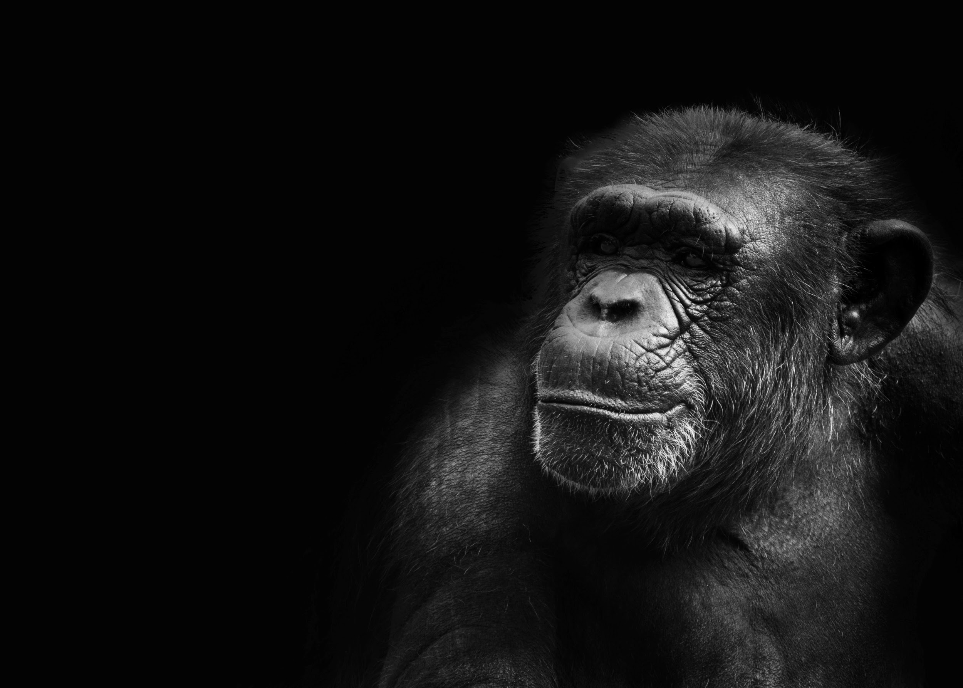
Contents
Problem Definition
Existing System
Project Overview
Input Output Screens
Limitations
Future Enhancements

Slide 3

PROBLEM DEFINITION
Many sites provided us quiz but with our Wildlife Impulse not only you can give quiz but also learn about wildlife through their interesting facts & watch videos.

Slide 4
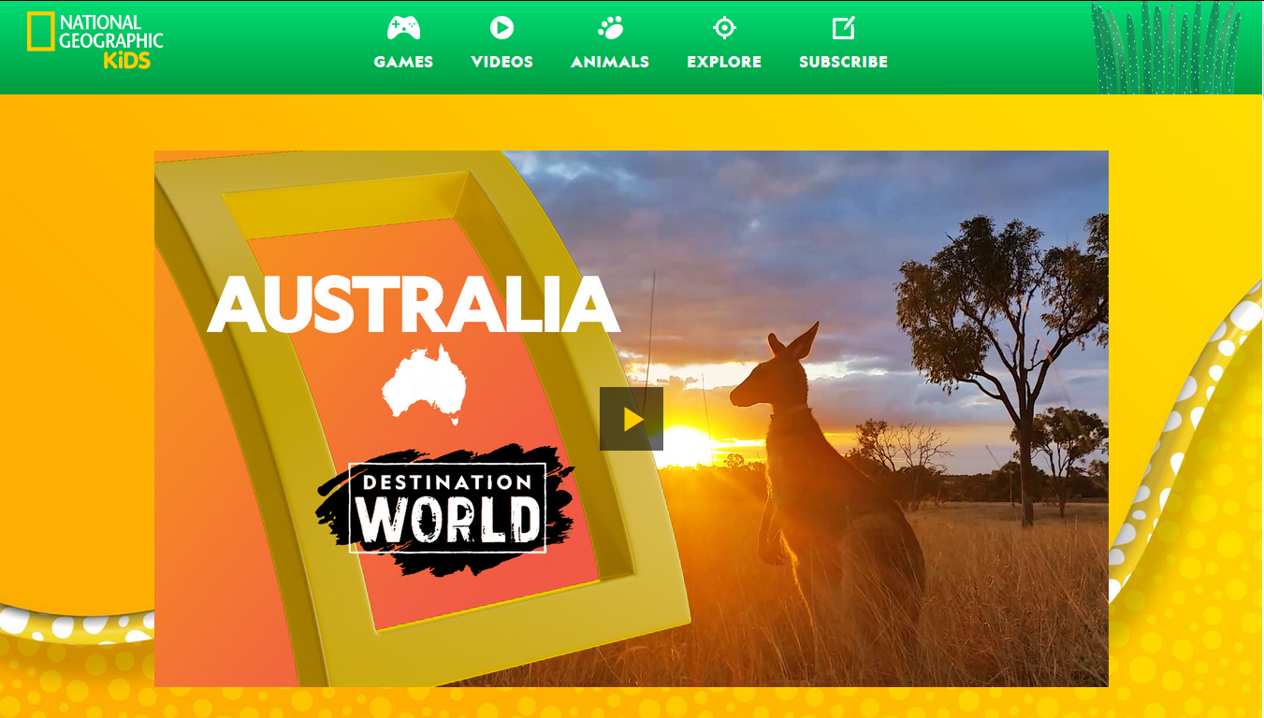
EXISTING SYSTEM
www.kids.nationalgeographic.com

Slide 5
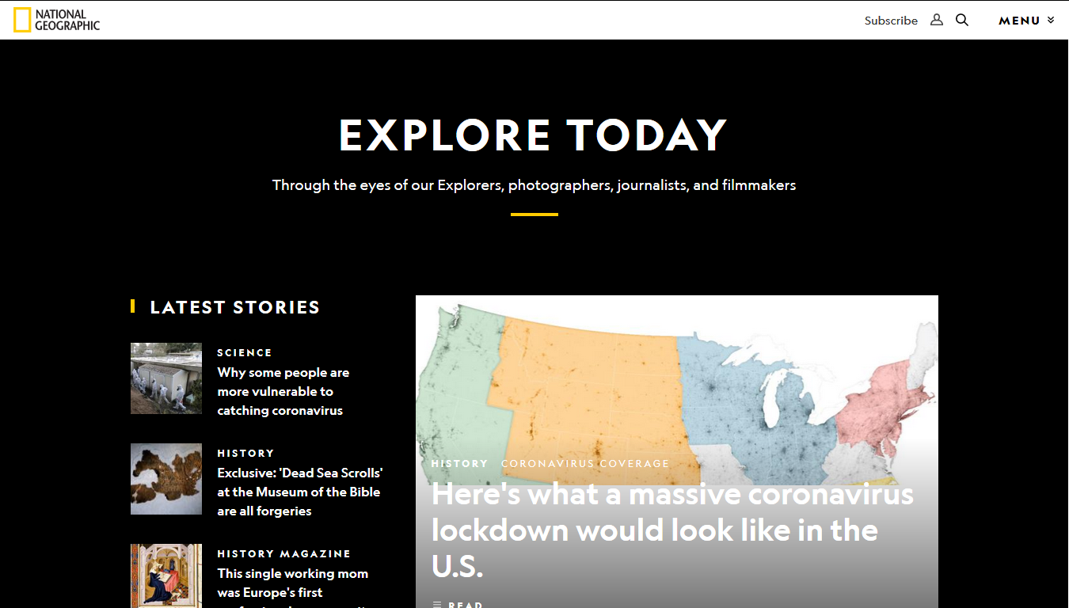
EXISTING SYSTEM
www.nationalgeographic.com

Slide 6

PROJECT OVERVIEW
Main page consists of short video.
Middle section contains four modules: Mammals, Marine, Birds & Reptiles.
End of page contains Facts section.
Each module contains 6-12 animals & video based on category.
After reading information, proceed to quiz.
Quiz contains 10 questions, answer all to proceed further.
Correct and wrong answer would be highlighted.

Slide 7
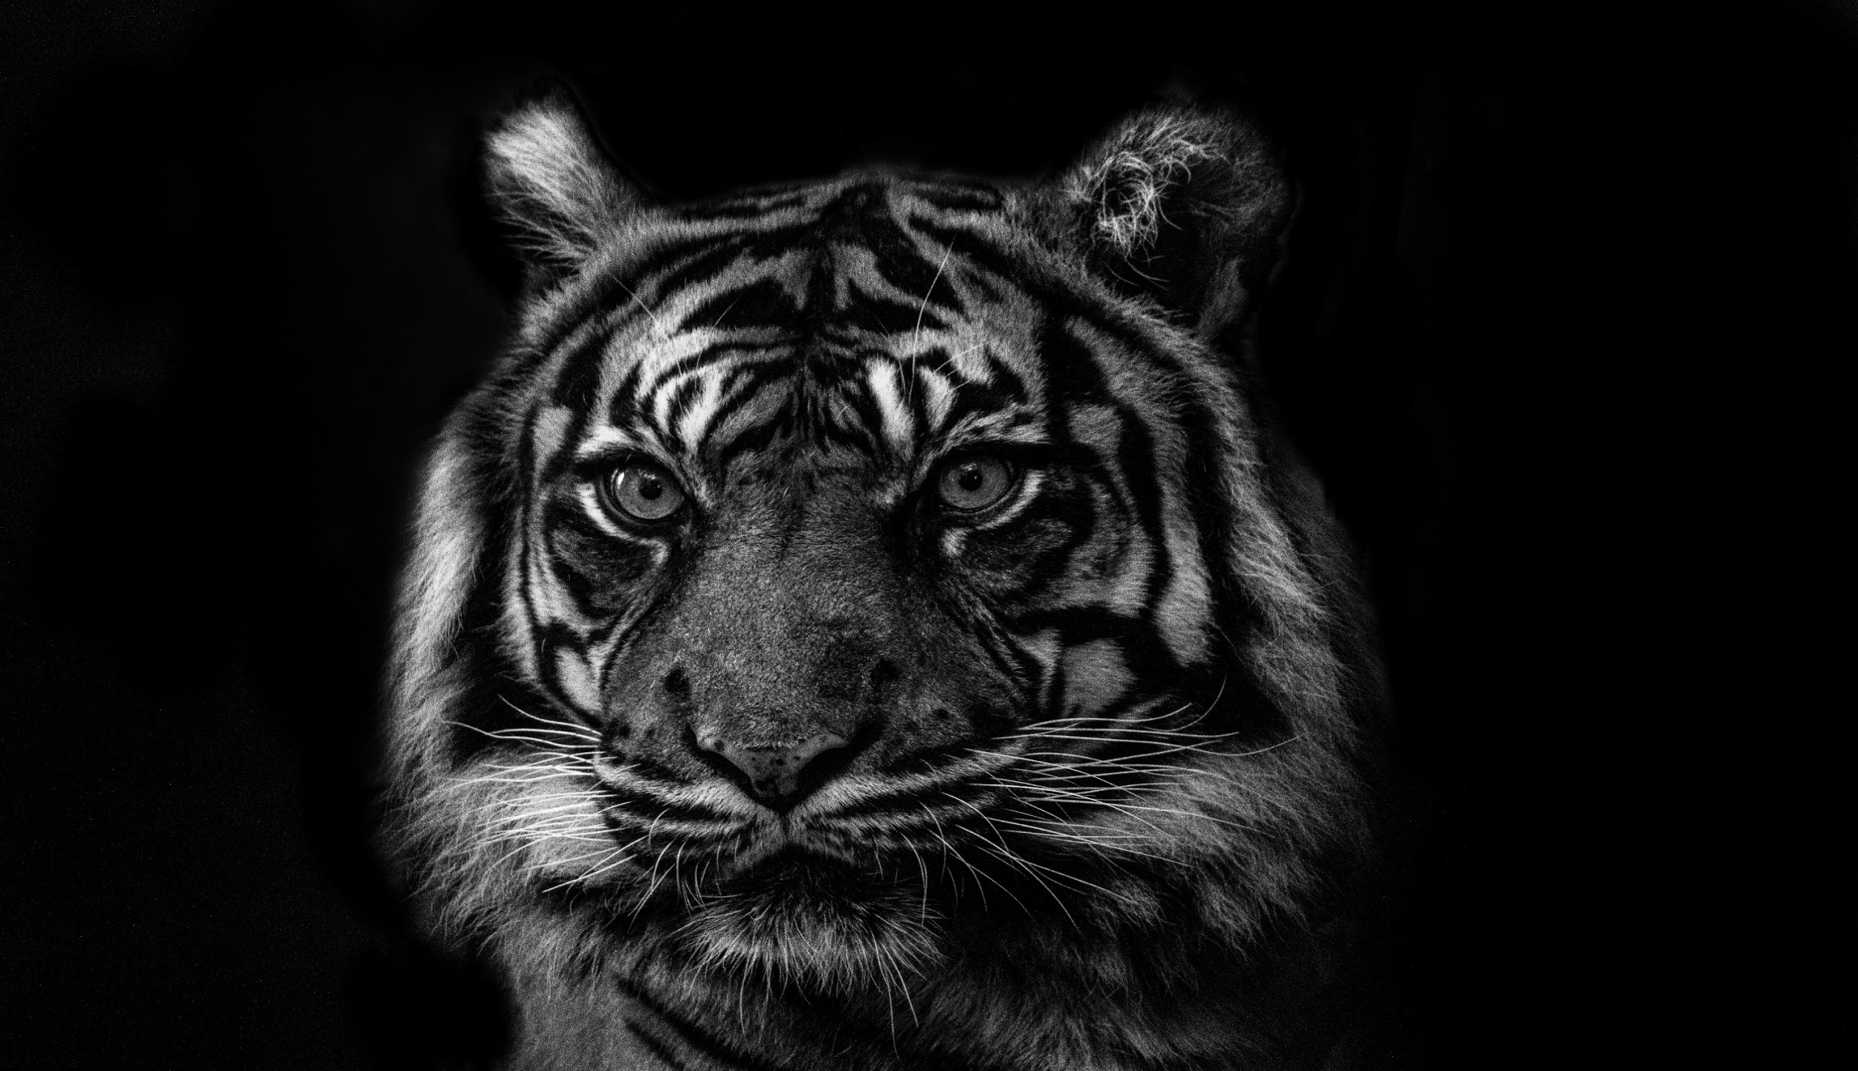
INPUT
OUTPUT
SCREENS

Slide 8
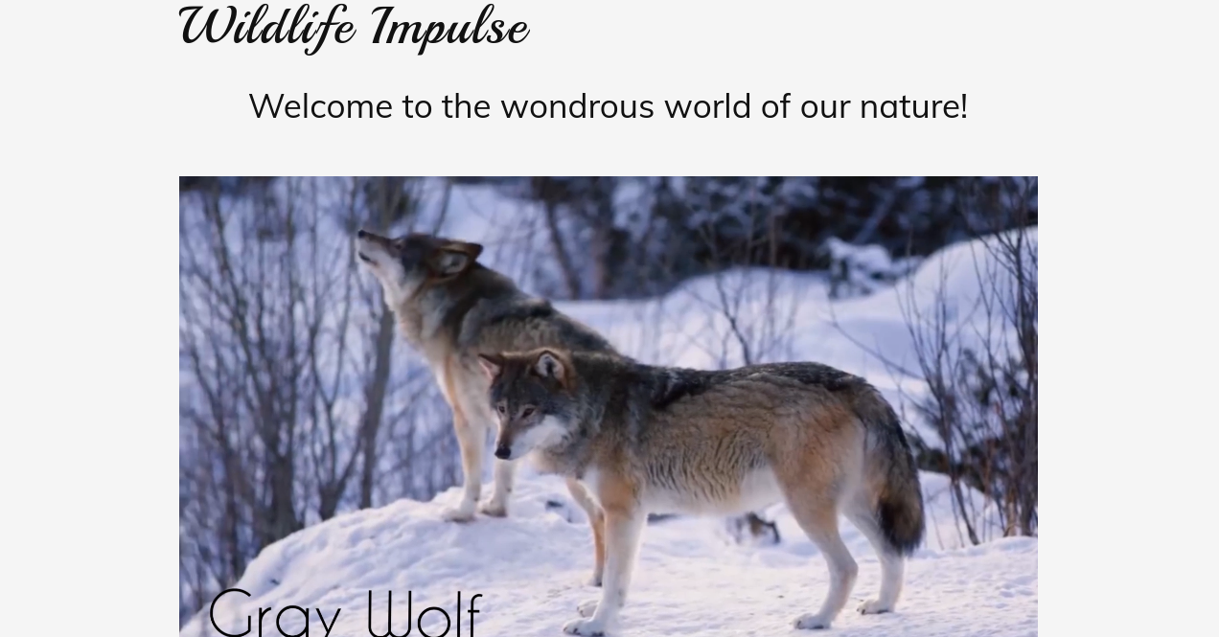

Slide 9
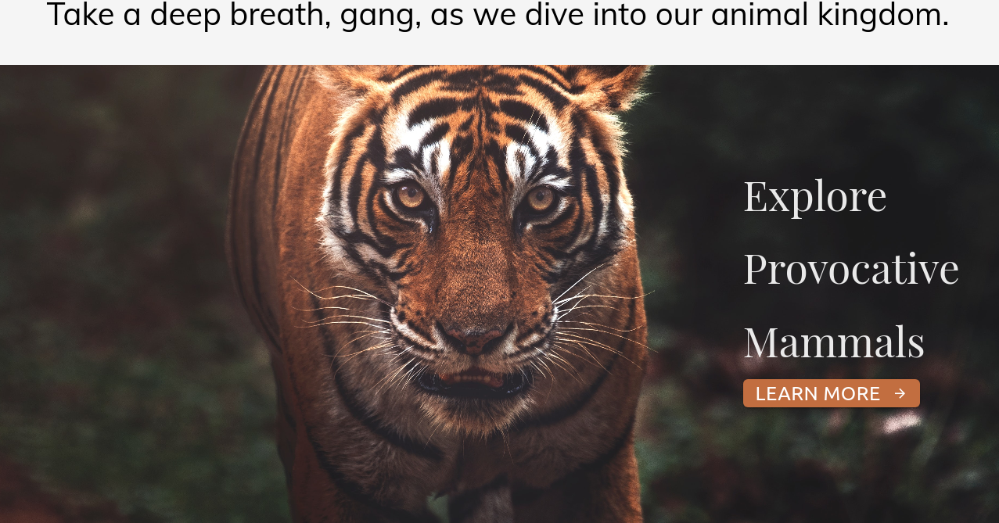

Slide 10
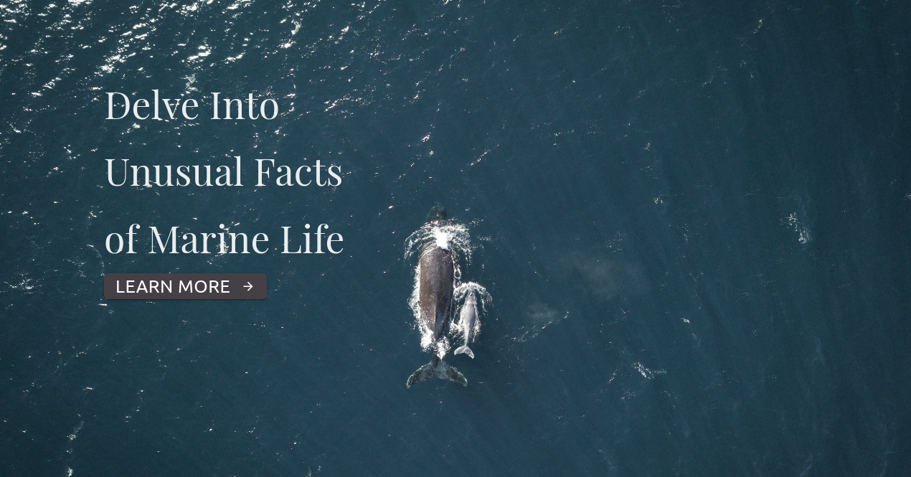

Slide 11
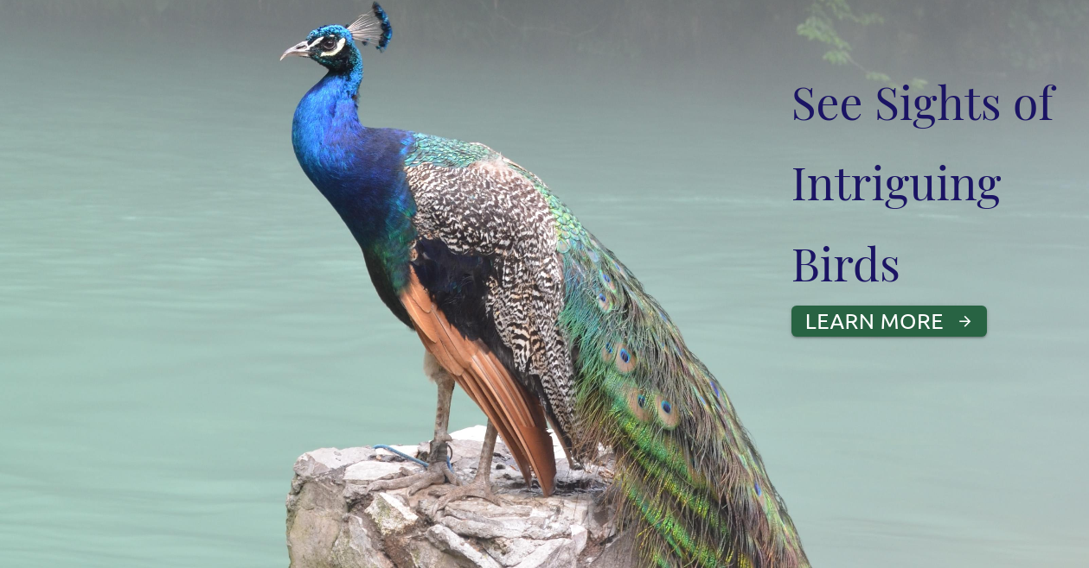

Slide 12
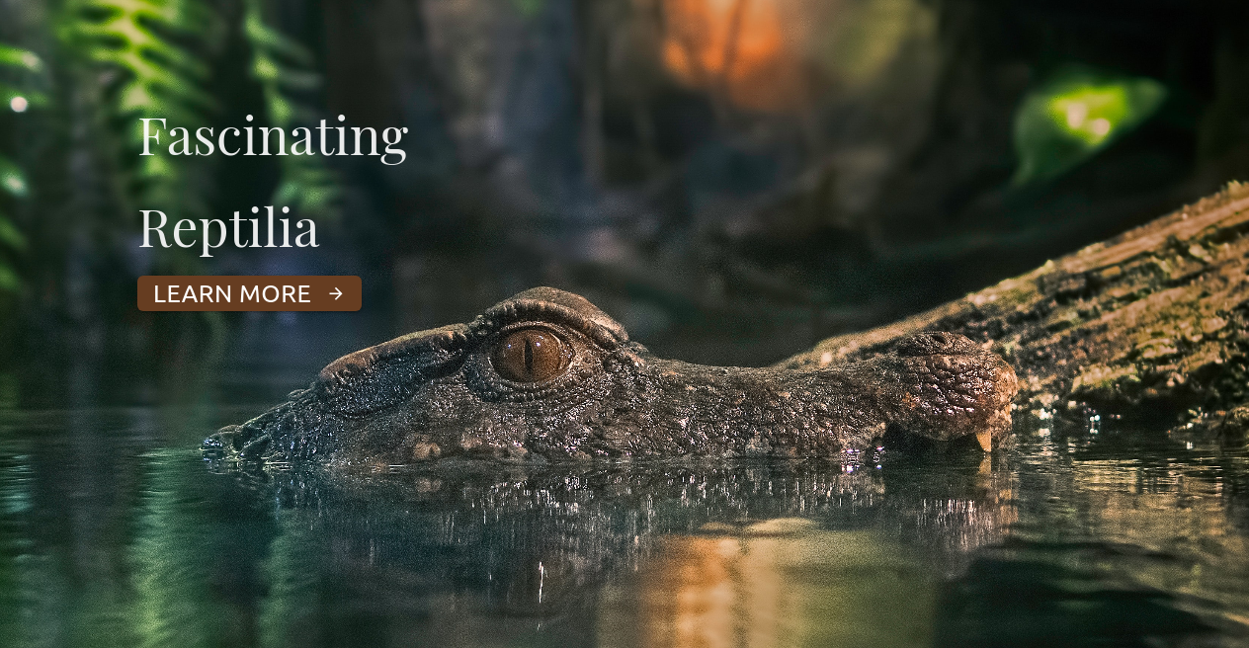

Slide 13
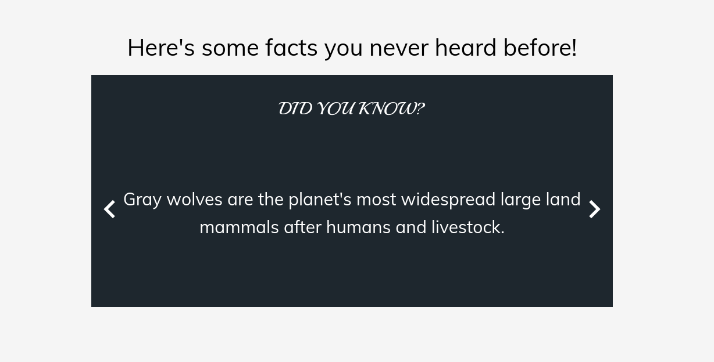

Slide 14
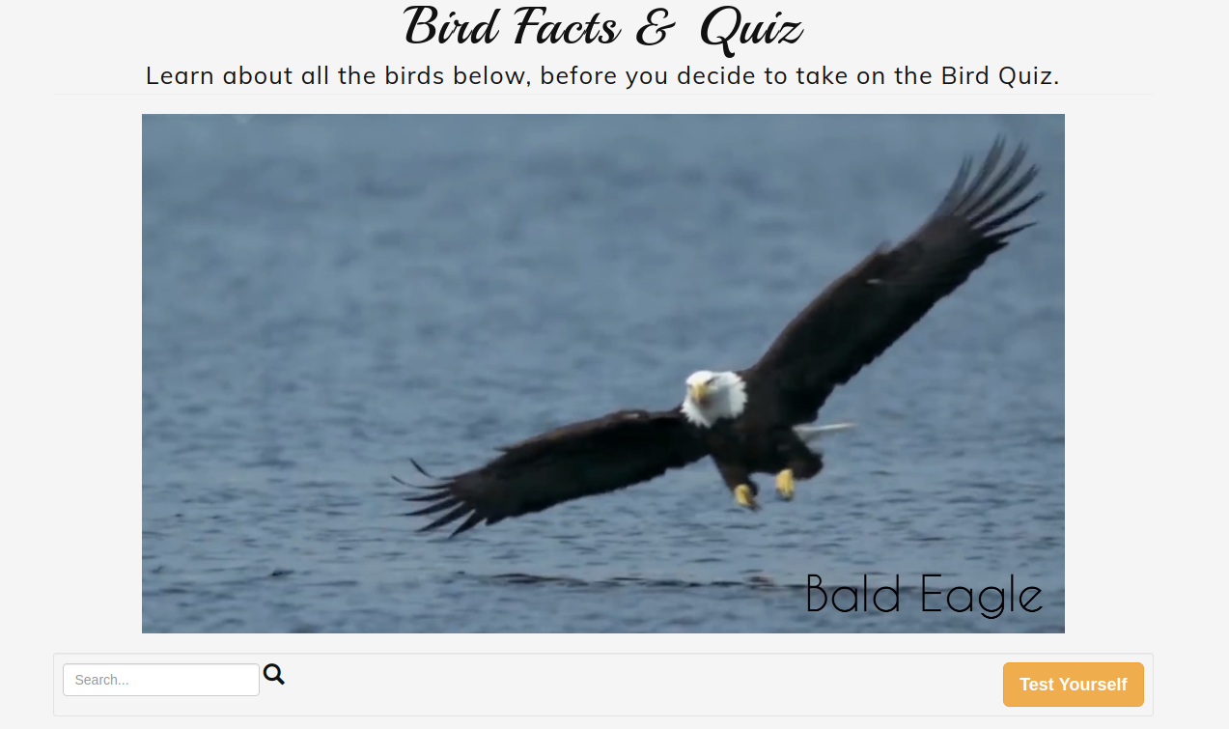

Slide 15
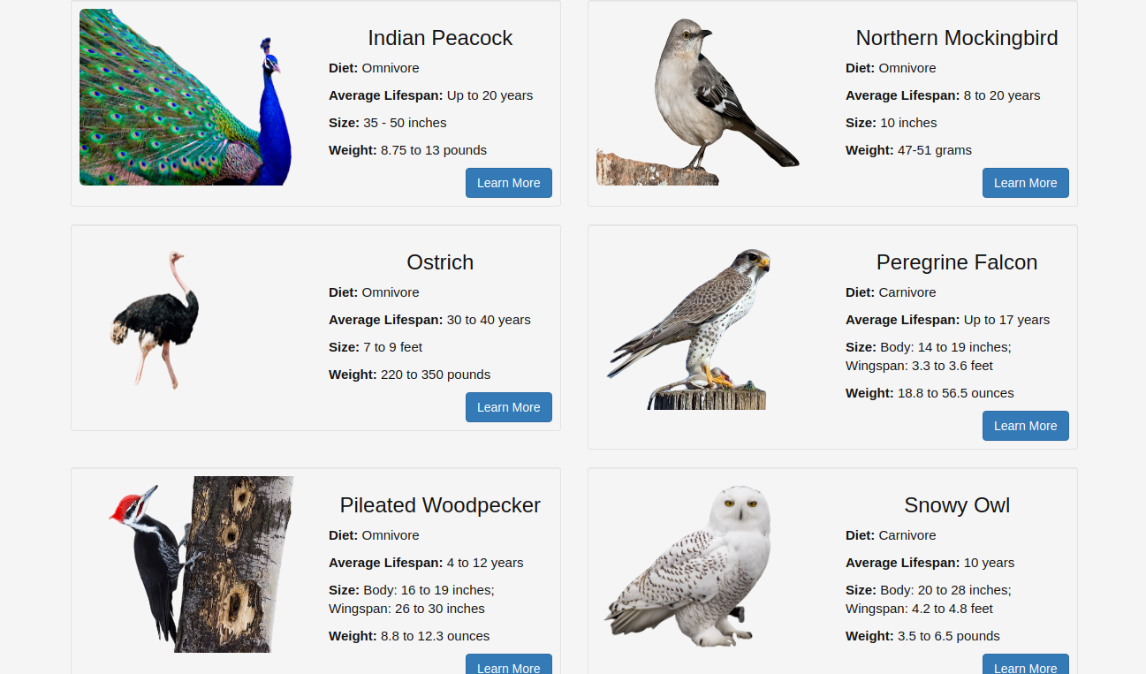

Slide 16
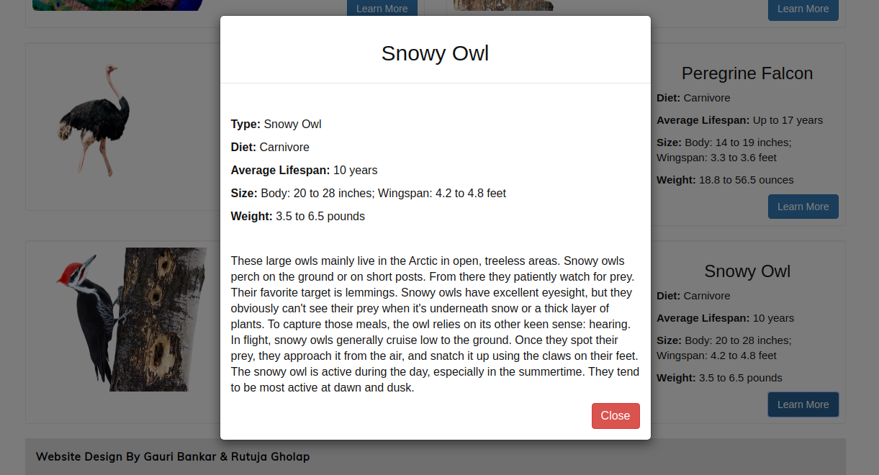

Slide 17
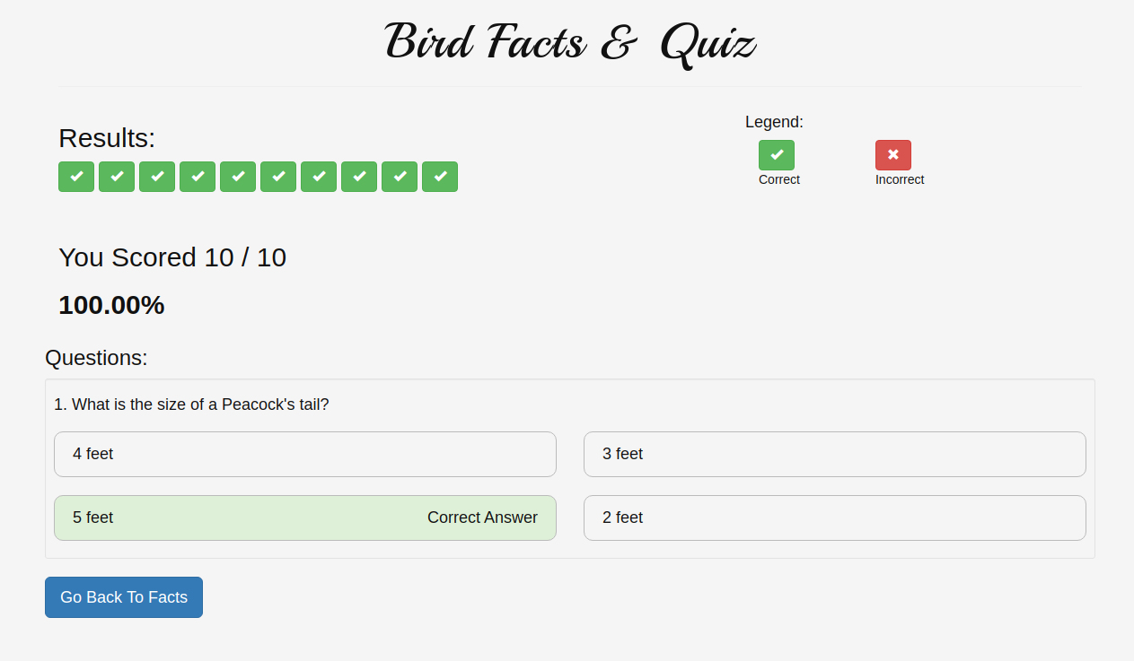

Slide 18
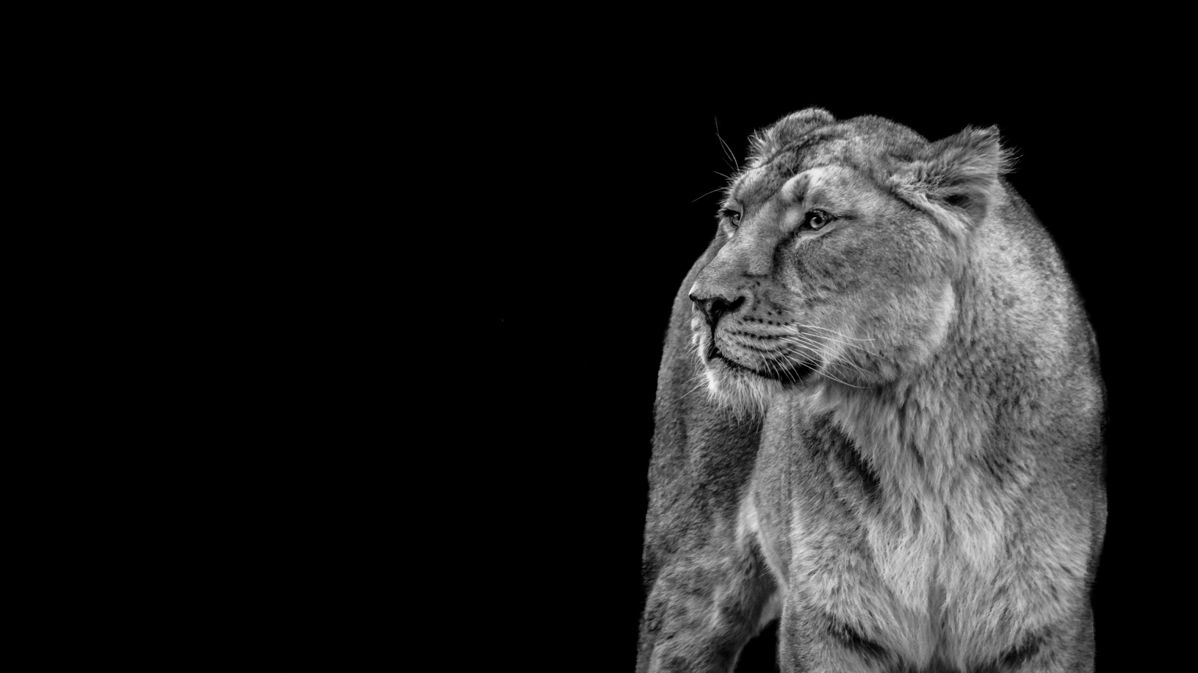
LIMITATIONS
Limited categories.
Video with no audio.
Quiz questions are not in random order.
Couldn’t provide videos and more images on each and every wildlife animals.

Slide 19
FUTURE ENCHANCEMENT
Create our own YouTube channel, that will have all the necessary videos and information.
Record and store any answer that the user gets wrong, and on completion of the quiz, give more information on that particular topic.
Add more categories in the system. Examples include, Plant Life, Space, History and many more.

